Slide 1

2016 Utah Nursing Education
Prepared by Clark Ruttinger, MPA, MBAc
Senior Institutional Research Analyst

Slide 2
Responses and survey updates
One of 29 states tracking education data
18 out of 20 institutions responded- (Two small private schools did not respond)
Important to continue to track schools newly opening and closing to ensure data is gathered from all sources
Changes
Moved data collection to start in January rather than October.
Added a question to distinguish between total institutional faculty and faculty by program.
Increased Accuracy
Third year of data being gathered by UMEC
Great cooperation and responsiveness. Thank you!

Slide 3
Licensed Practical Nurses 2010-2016
% of Total Current Enrollment
Snow | 8%
UCAT | 82%
USU | 10%

Slide 4
ADN Programs 2010-2016
 |  |  |  | % of Total Current Enrollment
 | Ameritech | Dixie State | Eagle Gate | Fortis | Snow | SLCC | USU | UVU | Weber
2015 | 19% | 5% | 2% | 6% | 2% | 27% | 3% | 9% | 28%
2016 | - | 13% | - | - | 3% | 32% | 5% | 10% | 38%

Slide 5
BSN Programs 2010 to 2016
% of Total Current Enrollment
 | BYU | Dixie | Eagle Gate | Provo | Roseman | SUU | U of U | UVU | Weber | Western Governor's | Westminster
2015 | 19% | 5% | 4% | 2% | 5% | 5% | 10% | 3% | 17% | 23% | 7%
2016 | 14% | 5% | 8% | - | 4% | 5% | 13% | 4% | 15% | 24% | 7%

Slide 6
Nursing Masters Programs 2010 to 2016
 | % of Total Current Enrollment
 | BYU | U of U | UVU | Weber | Western Governors | Westminster
2015 | 9% | 14% | 2% | 14% | 33% | 29%
2016 | 8% | 7% | 2% | 18% | 40% | 26%

Slide 7
DNP Programs 2010 to 2016
% of Total Current Enrollment
 | Rocky Mountain | U of U
2015 | 4% | 96%
2016 | 17% | 83%

Slide 8
Student Diversity 2014-2016

Slide 9
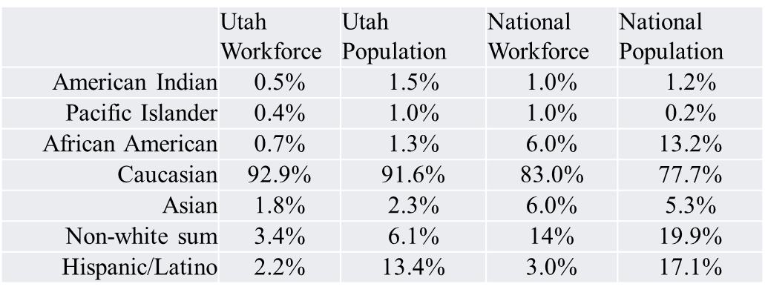
State and National Workforce Comparisons

Slide 10
BSN Grads as % of total RN grads 2010-2016
Notes:
Hesitancy to project a growth trend to predict when BSN prepared grads reach 80% since there is little available information about what programs intend to do into the future. Will ADN programs continue to grow? Will BSN programs grow? Will new programs be created or converted into BSN programs?
If we do use this past 7 years as a predictor for the future, BSN graduates are gaining share of total RN grads at a rate of about 7% per year.

Slide 11
ADN to BSN Graduates 2008 to 2016
Notes:
This projection assumes that BSN programs will continue to grow as a % of RN programs (which may not be true).
It accounts for what appears to be a very slight slowing of the growth rate each year (1%).
Program specific plans for growth would need to be taken into account to get a more accurate projection.

Slide 12
Utah RN Workforce 2015 (From 2014 RN Supply Survey)
76% of RNs licensed in Utah reported their state of initial licensure being Utah
64% of RNs whose initial license was not in the state of Utah report preparation at a BSN degree or higher
Notes:
BSN Graduates aren’t exactly the metric we are looking for in measuring the RWJ goal, although they do eventually translate into the RN workforce.
The majority of RNs whose initial license came from another state are BSN prepared or higher. This means we are importing more BSNs

Slide 13
Faculty Diversity 2016
 | Utah Workforce | Utah Population | National Workforce | National Population
American Indian | 0.5% | 1.5% | 1.0% | 1.2%
Pacific Islander | 0.4% | 1.0% | 1.0% | 0.2%
African American | 0.7% | 1.3% | 6.0% | 13.2%
Caucasian | 92.9% | 91.6% | 83.0% | 77.7%
Asian | 1.8% | 2.3% | 6.0% | 5.3%
Non-white sum | 3.4% | 6.1% | 14% | 19.9%
Hispanic/Latino | 2.2% | 13.4% | 3.0% | 17.1%
Faculty- 2% Hispanic

Slide 14
Faculty Age 2014-2016

Slide 15
Faculty Need 2015-2016
Notes:
High need for BSN faculty could be an indicator that the trend toward 80% BSN prepared workforce is on track

Slide 16
Recommendations
Develop common goals for nursing workforce production at every level for the state, based on population needs.
Continue monitoring:
Diversity
Faculty age/need
80% BSN by 2020 goal
Development of self service data analysis

Slide 17
Questions?
Ad Hoc analysis of any of the data is available.
Raw data is available on any or all questions.
Contact Information
Clark Ruttinger MPA, MBAc
Senior Institutional Research Analyst
Utah Medical Education Council
Utah Nursing Workforce Information Center
crutting@utah.gov
801-526-4564

